Slide 1

User Experience and User Interface Design
6 - Android UI Design Introduction - User Input
Dr. Seyed Reza Shahamiri More Info

Slide 2
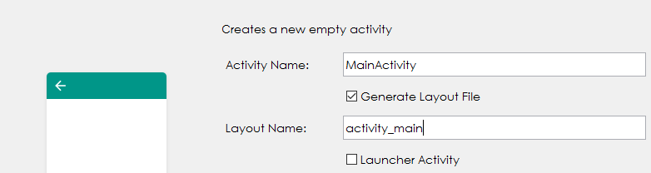

Activity
2
Each layout activity (the UI xml code) should be associated with a Java class file known as activity that provides the background code for that activity.
If you add an activity by using “Empty Template”, the java activity file will be automatically inserted to your project:
More information

Slide 3
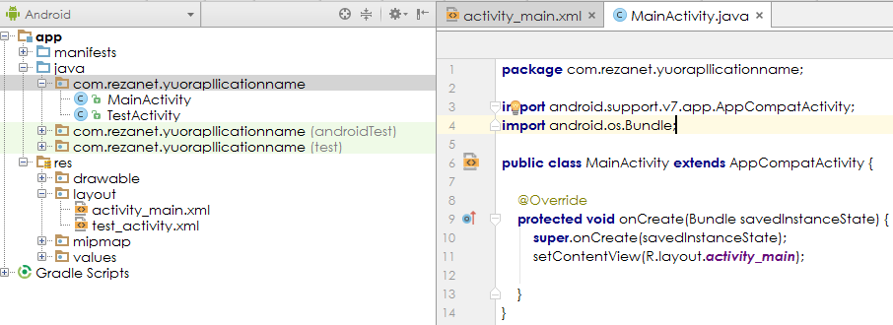
Activity
3
Android Studio automatically adds some java code to the activity based on the template that you select.

Slide 4
User Input
4
Nearly every popular application involves accepting some type of user inputs and processing that data.
Hence, knowing how to accept user input is a critical milestone on the way to becoming an experienced developer.

Slide 5
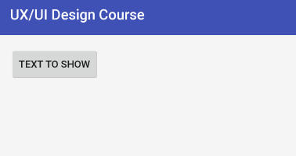
Button
5
One type of View is a Button, which displays a piece of text and enabling the user to tap the text.
When touched, a properly configured Button tells the Android device to execute a method containing a list of instructions.
Button guide
<Button android:layout_width="wrap_content" android:layout_height="wrap_content" android:text="Text to show"/>

Slide 6
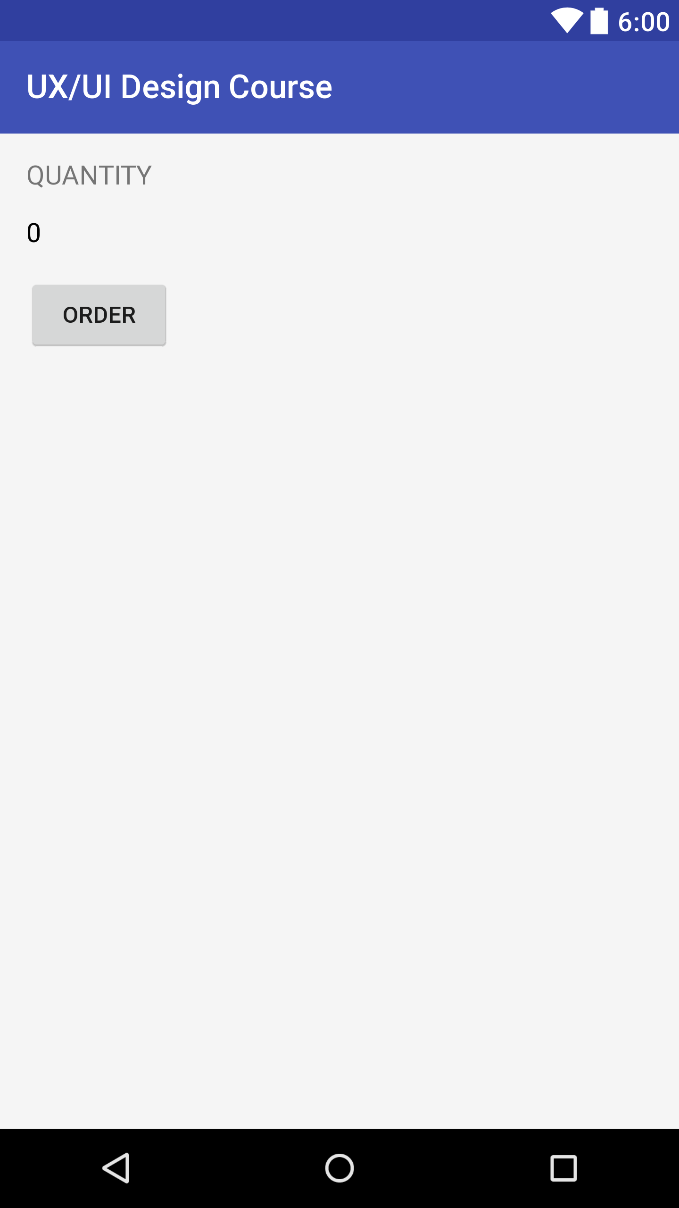
Button Order App
6
Create a new project and name it OrderApp
Open activity_main.xml
Design the following UI
Set the second TextView id to "@+id/quantity_text_view“
Run the app on your device and press the ORDER button. What happens?

Slide 7
Button Order App Accessing views in the activity
7
We can access views that have their id attributes set in their associated java activities in order to read or manipulate their attributes:
First, in the java activity class, we need to get a reference to the view by initializing an object of the view. For example, if the view is a TextView:
Import the TextView class to your activity at the top of the activity java file:
Declare and initialize a TextView object inside the class method that points to the specific TextView:
where quantity_text_view is the id of the TextView in the xml file.
Now you can access quantityTextView attributes in your code.
import android.widget.TextView;
TextView quantityTextView = (TextView) findViewById(R.id.quantity_text_view);

Slide 8
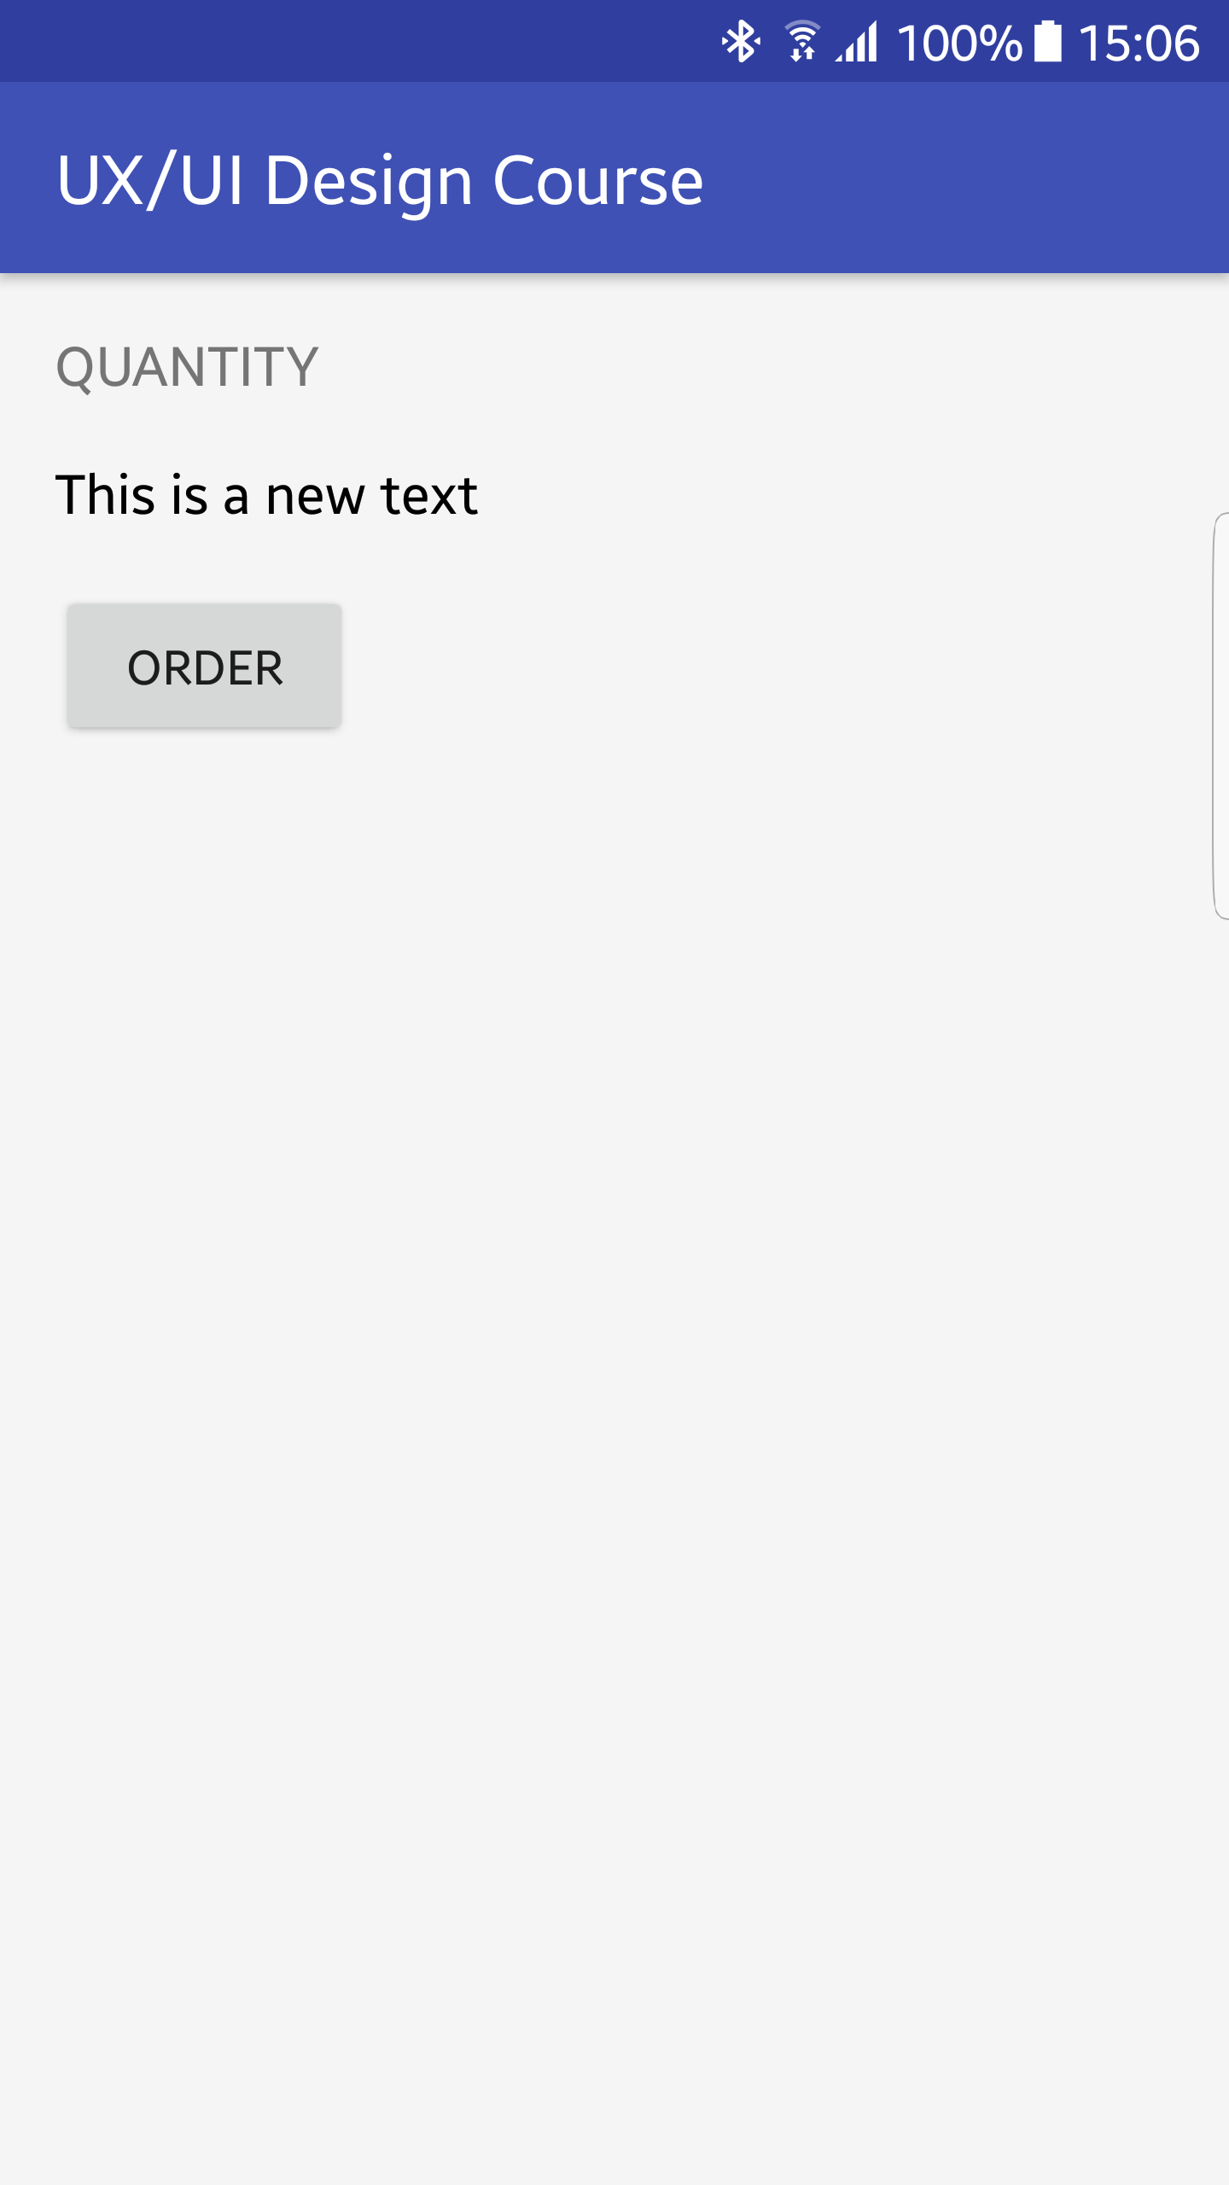
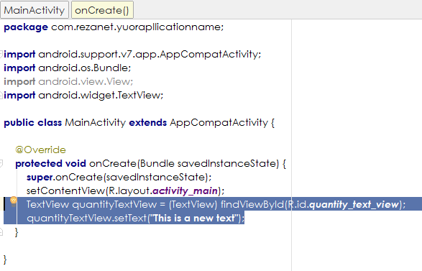
Button Order App Accessing views in the activity
8
For example, update the onCreate() function by adding this code to it, and then run the app:

Slide 9
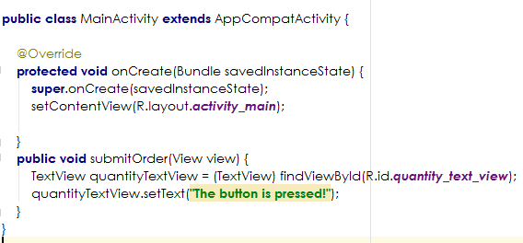
Button Order App 1. Program Buttons
9
Every time the user presses the button, an event is fired informing the java activity class that the button was pressed.
You need to capture that event and instruct the app how to process this user request by defining a function that receives a View as input parameter. For example, the following function updates quantity_text_view to show a text when the ORDER button is pressed:

Slide 10
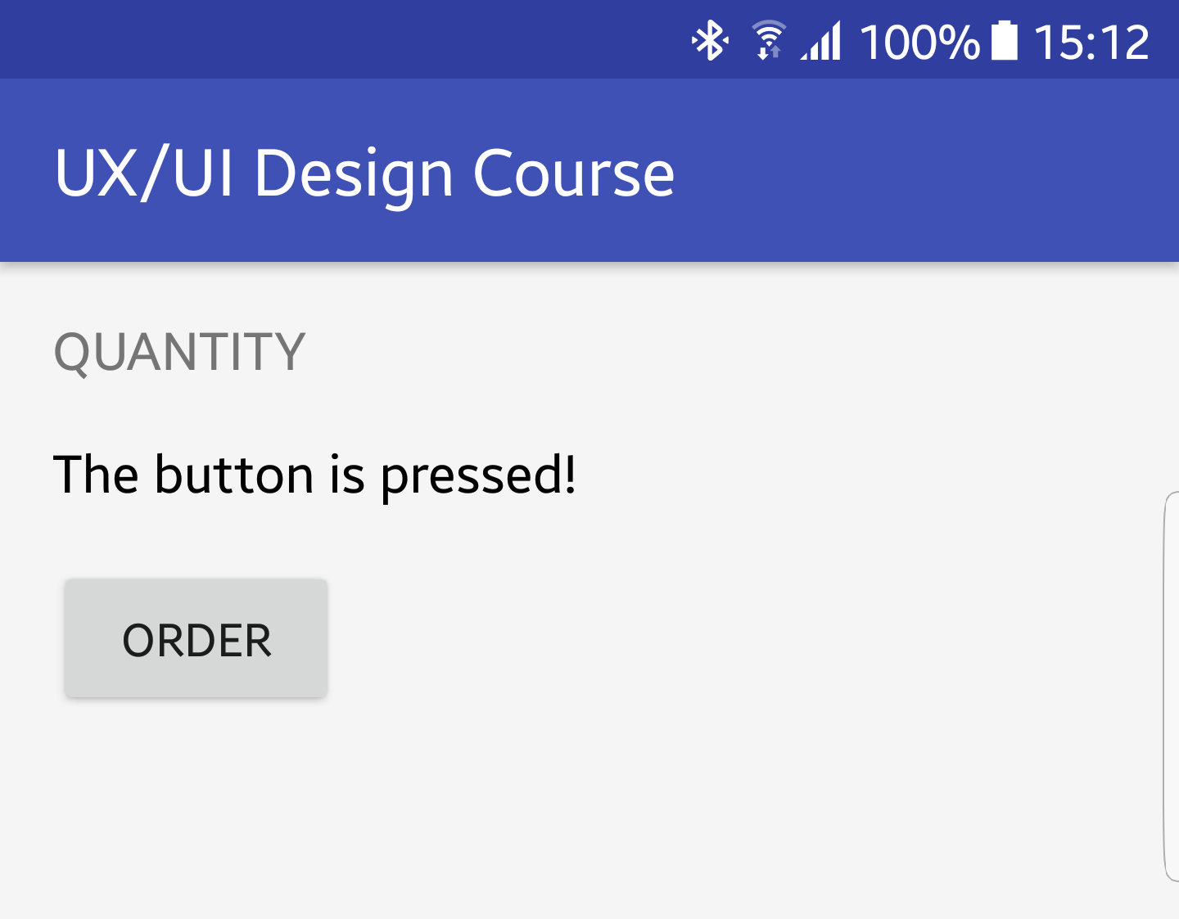
Button Order App 2. Program Buttons
10
You also need to tell the Button what function handles the press event by setting onClick attribute to point to the function:
Run the app and press the button to see the results:
<Button android:layout_width="wrap_content" android:layout_height="wrap_content" android:text="Order" android:onClick="submitOrder"/>

Slide 11
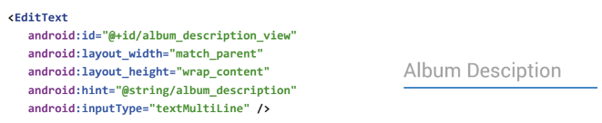
EditText
11
EditText provides a text field so that the users can enter some values.

Slide 12
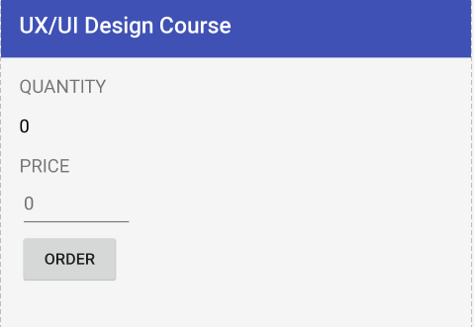
EditText Order App
12
Add the following TextEdit to the UI:
<EditText android:id="@+id/price_edit_view" android:layout_width="100dp" android:layout_height="48dp" android:hint="0" android:textSize="16sp" android:inputType="number" />
Limiting the user to only enter numbers

Slide 13
EditText Order App Accessing the text
13
Accessing the text content of the EditText is by:
Getting a reference to the EditText in the java activity:
priceTextEdit.getText() returns the content of the EditText.
EditText priceTextEdit =(EditText) findViewById(R.id.price_edit_view);

Slide 14
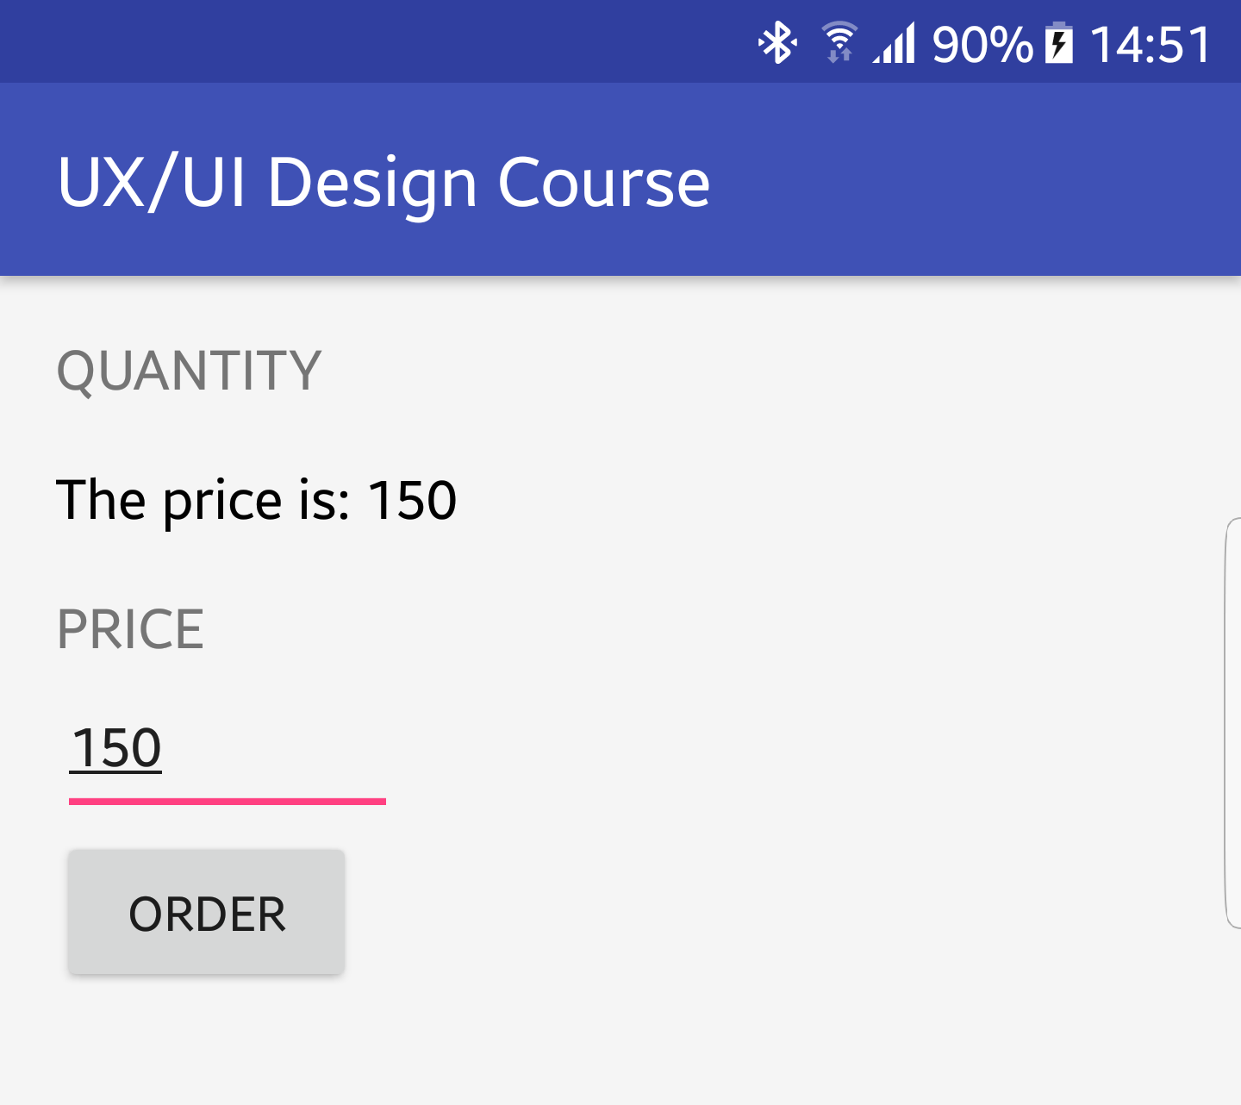
EditText Order App
14
Modify the submitOrder event handler as follows, then run the app, enter a price, and click the button:
public void submitOrder(View view) { EditText priceTextEdit =(EditText) findViewById(R.id.price_edit_view); TextView quantityTextView = (TextView) findViewById(R.id.quantity_text_view); quantityTextView.setText("The price is: " + priceTextEdit.getText()); }

Slide 15
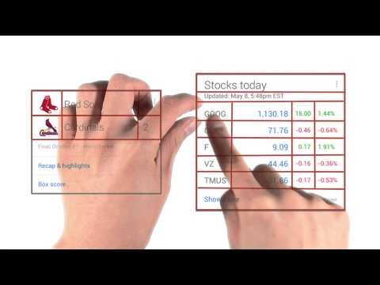
Nested ViewGropus
15

Slide 16
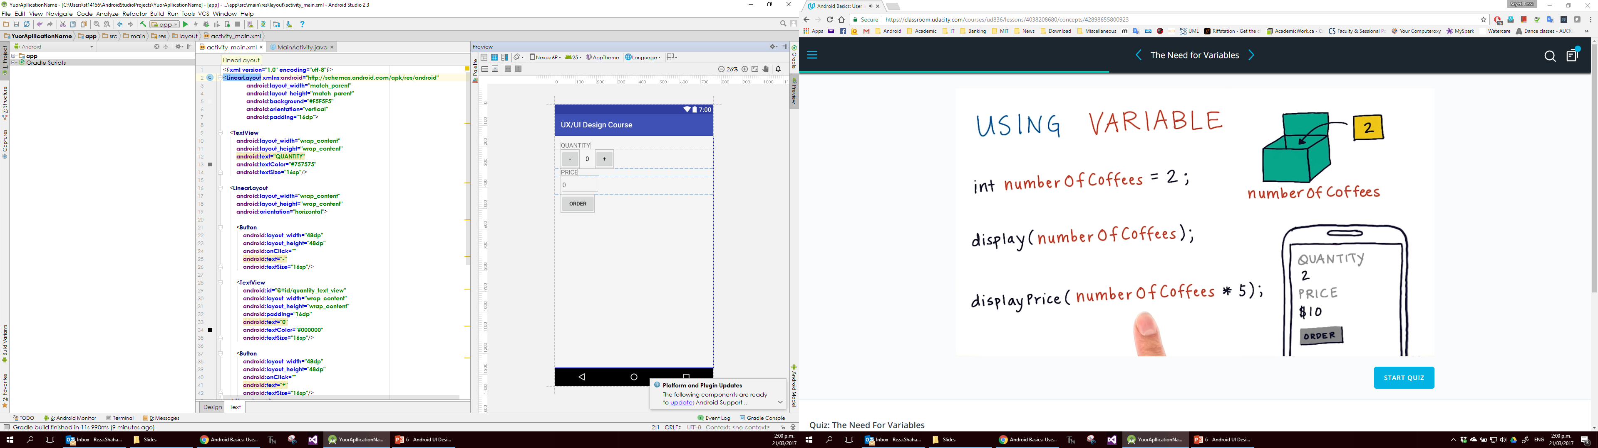
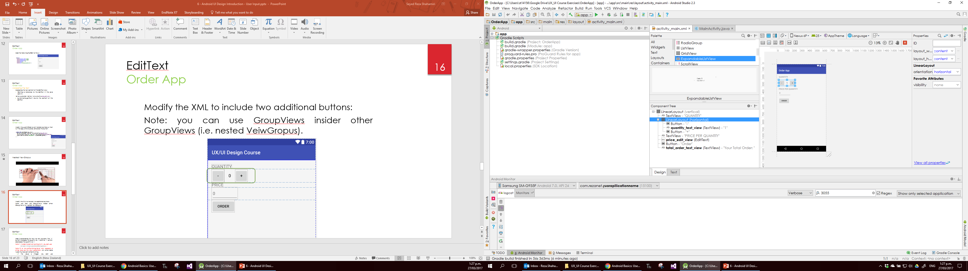
EditText Order App
16
Modify the XML to include two additional buttons:
Note: you can use GroupViews inside other GroupViews (i.e. nested VeiwGropus).

Slide 17
EditText Order App
17
Add functionalities for the two new buttons. The “+” button increases the quantity by 1, and the “-” button, decreases the quantity by 1.
Note 1: In order to convert a string to int, you can use:
Note 2: a view.setText(stringValue) only accepts a string value as the input parameter. Any other data types must be converted to string.
If the value is integer, you can use Integer.toString(theIntValue)
int num1 = Integer.parseInt(theStringValue);

Slide 18
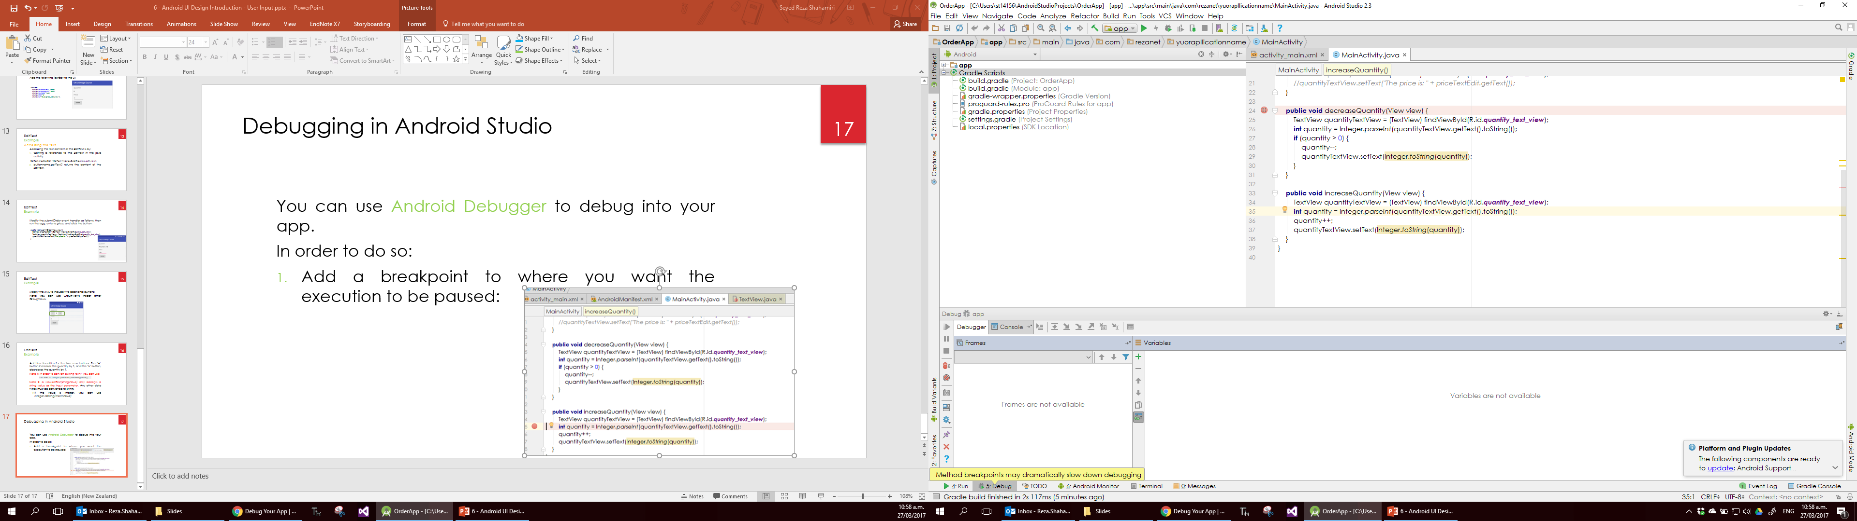
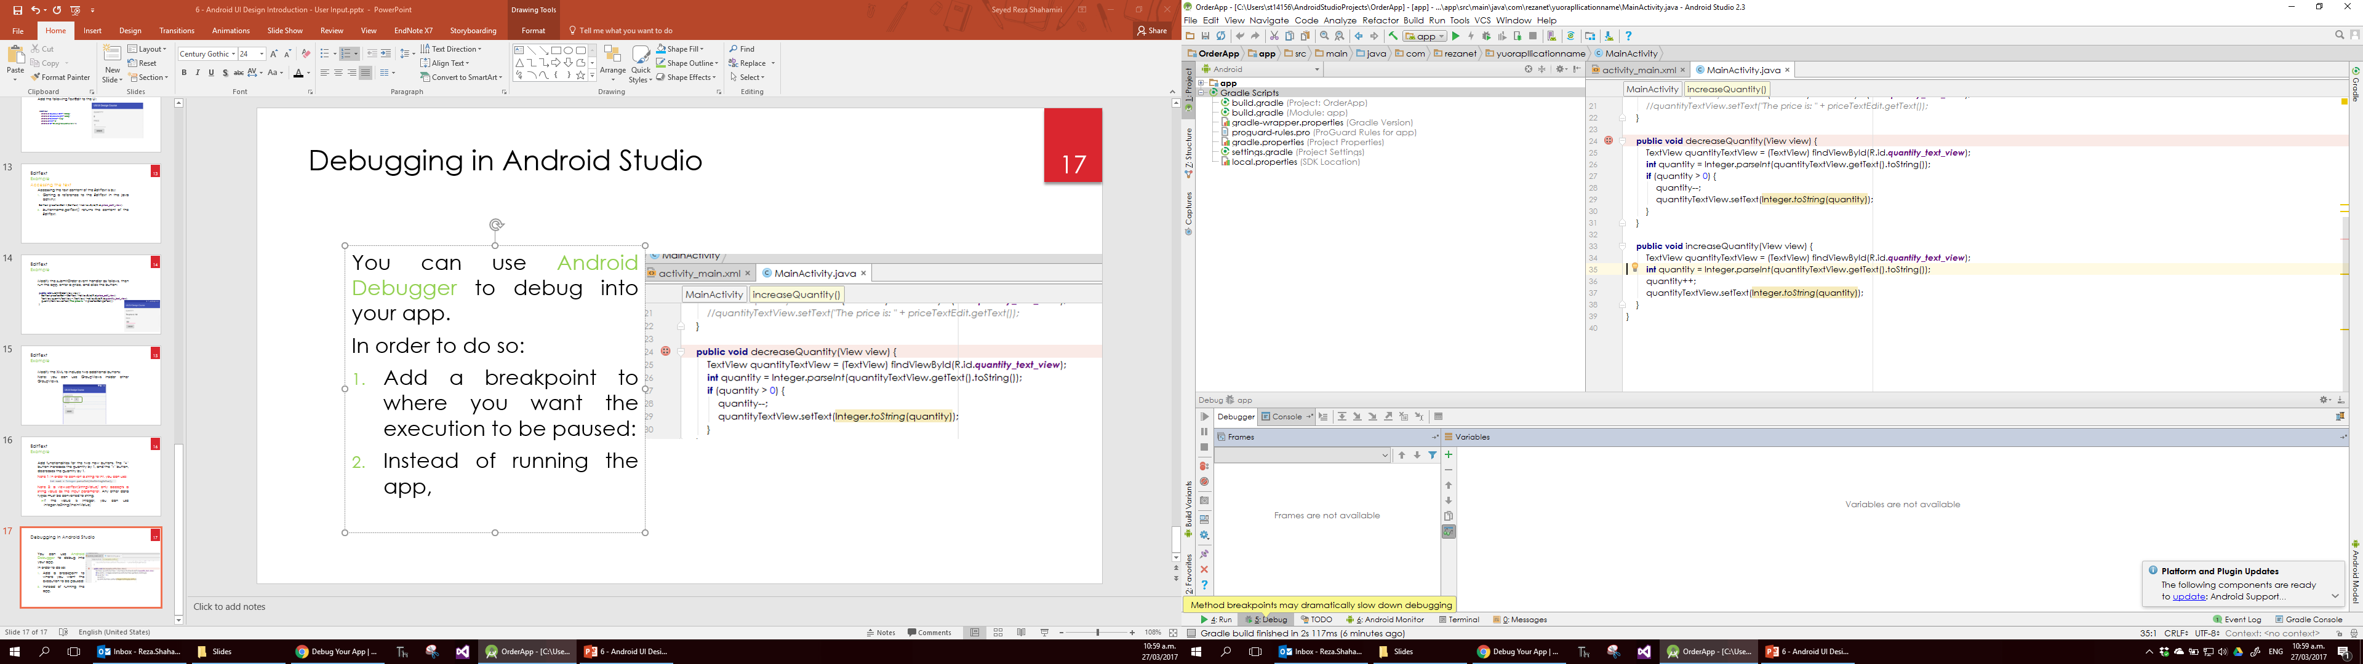
Debugging in Android Studio
18
You can use Android Debugger to debug into your app.
In order to do so:
Add a breakpoint to where you want the execution to be paused:
Instead of running the app, press Debug App button.

Slide 19
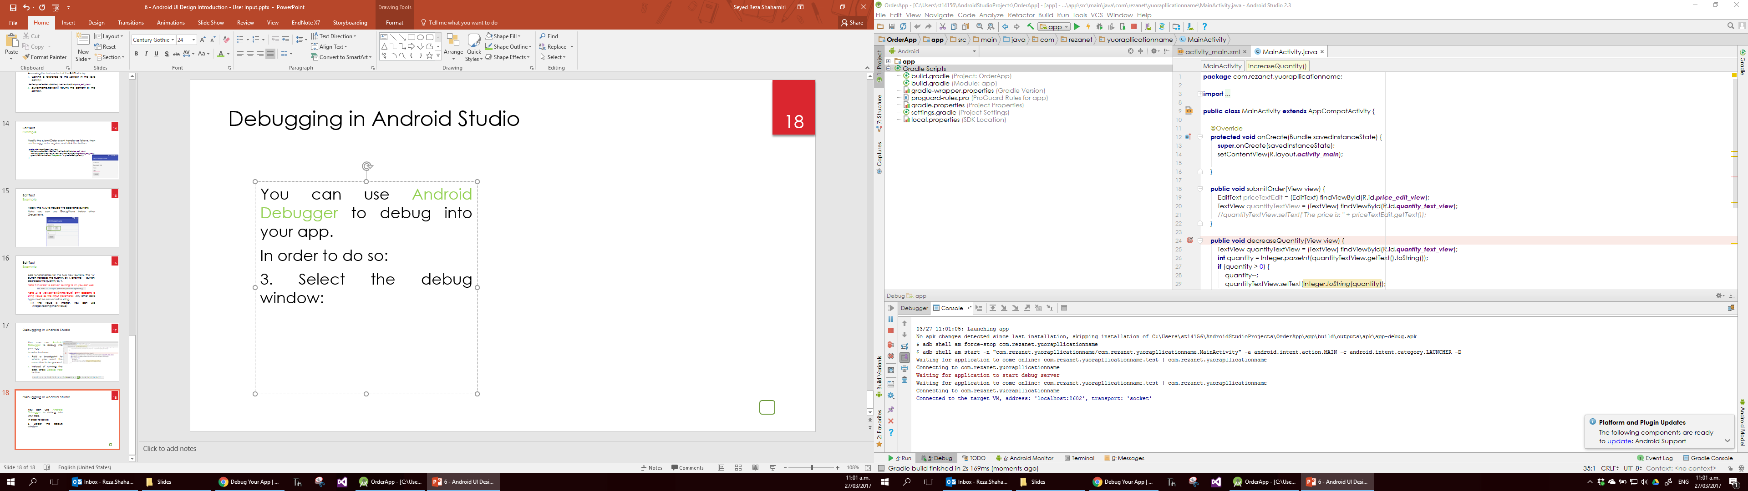
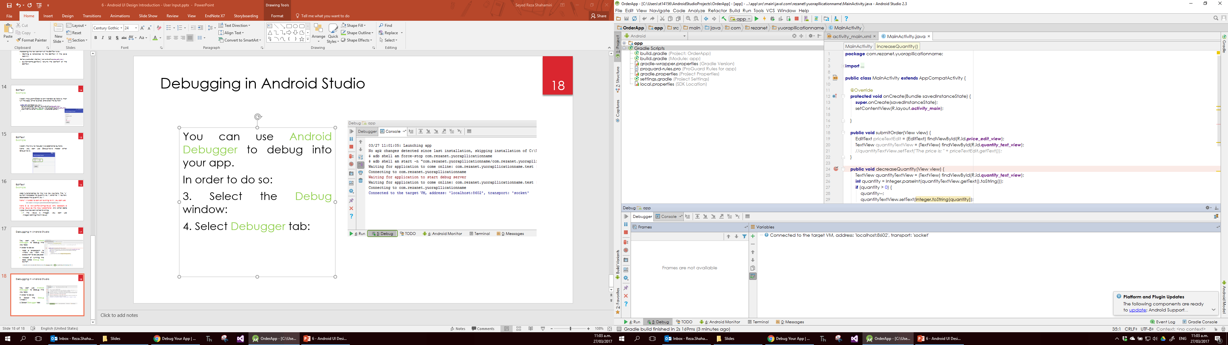
Debugging in Android Studio
19
You can use Android Debugger to debug into your app.
In order to do so:
3. Select the Debug window:
4. Select Debugger tab:

Slide 20
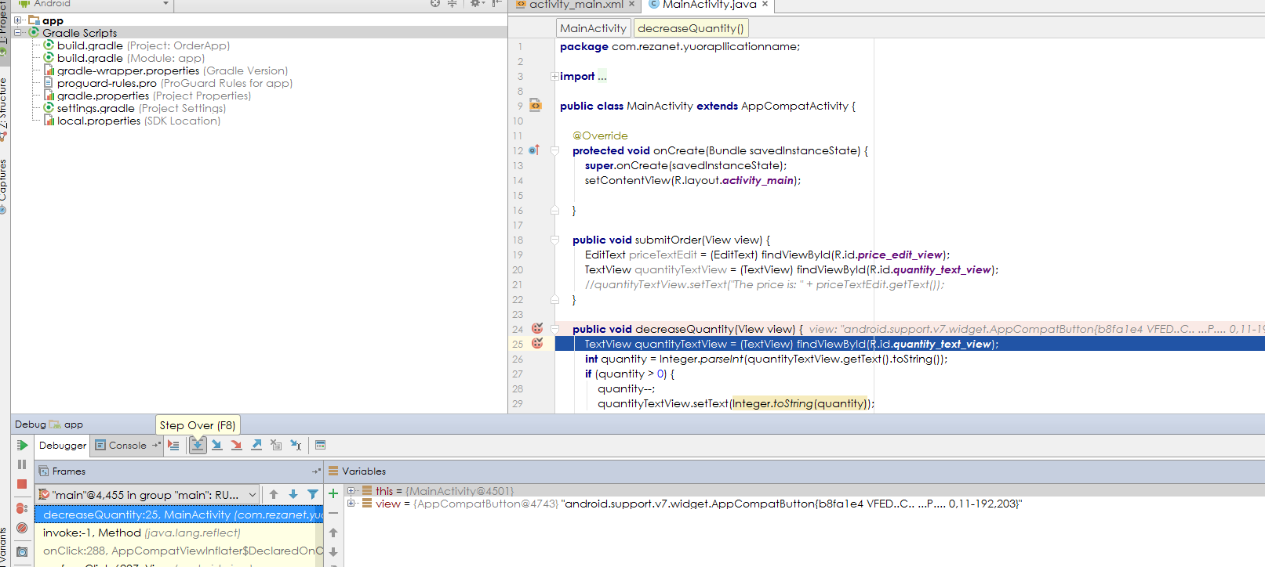
Debugging in Android Studio
20
Execution is paused here
You can run the code line-by-line using these buttons
You can see the current content of objects and variables

Slide 21
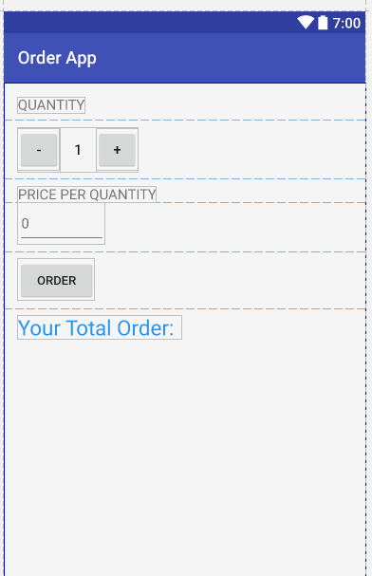
Order App
21
Add a new TextView and set the id to total_order_text_view.
Also, fix the margin attributes of the controls so that each control has a 16dp vertical margin to the others.

Slide 22
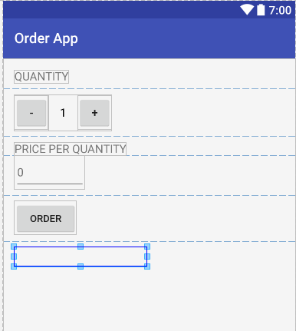
Order App
22
Then set the visibility attribute of the total order text view to:
android:visibility="invisible"

Slide 23
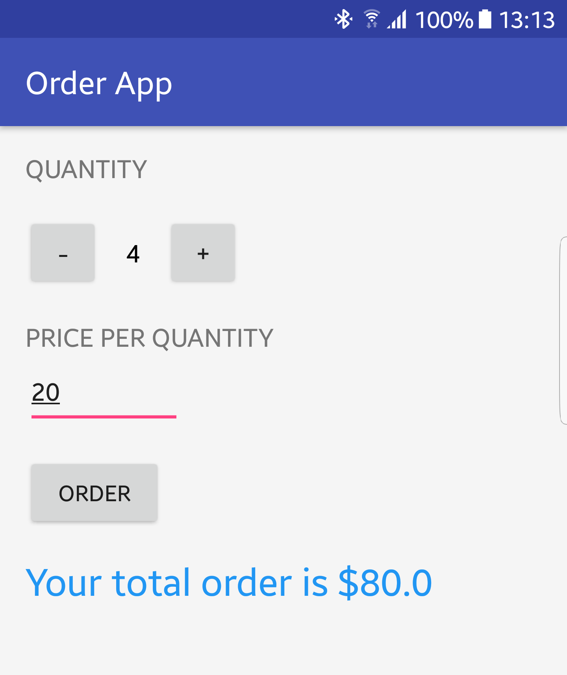
Order App
23
Modify the submitOrder event handler to calculate the total price and show it. It should also make the total text view visible:
theViewName.setVisibility(View.VISIBLE);

Slide 24
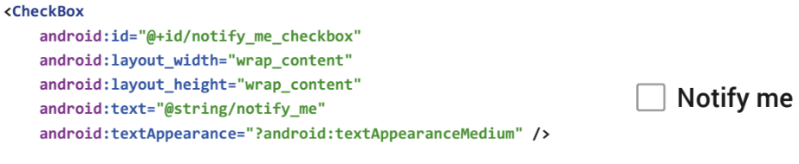
Check Box
24
A checkbox is a specific type of two-states button that can be either checked or unchecked.
Your code can access the checked state to understand user’s preference by using isChecked() method. It returns true if the it’s checked and false otherwise.

Slide 25
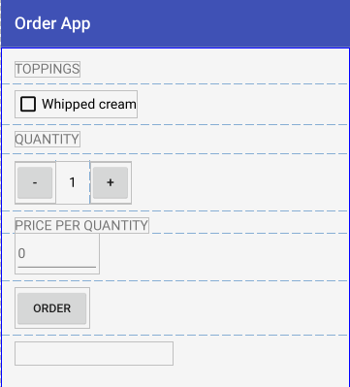
Check Box Order App
25
Modify the app by adding a checkbox and a new TextView.
Set the required attributes to make them consistent with the UI.
Set the ID attribute of the CheckBox to
android:id="@+id/checkbox_whipped_cream"

Slide 26
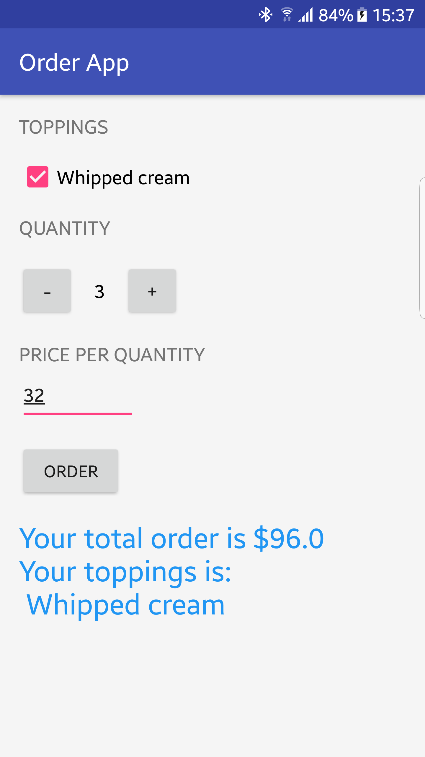
Check Box Order App
26
Modify the submitOrder to query the checkbox and show whether any toppings is selected.

Slide 27
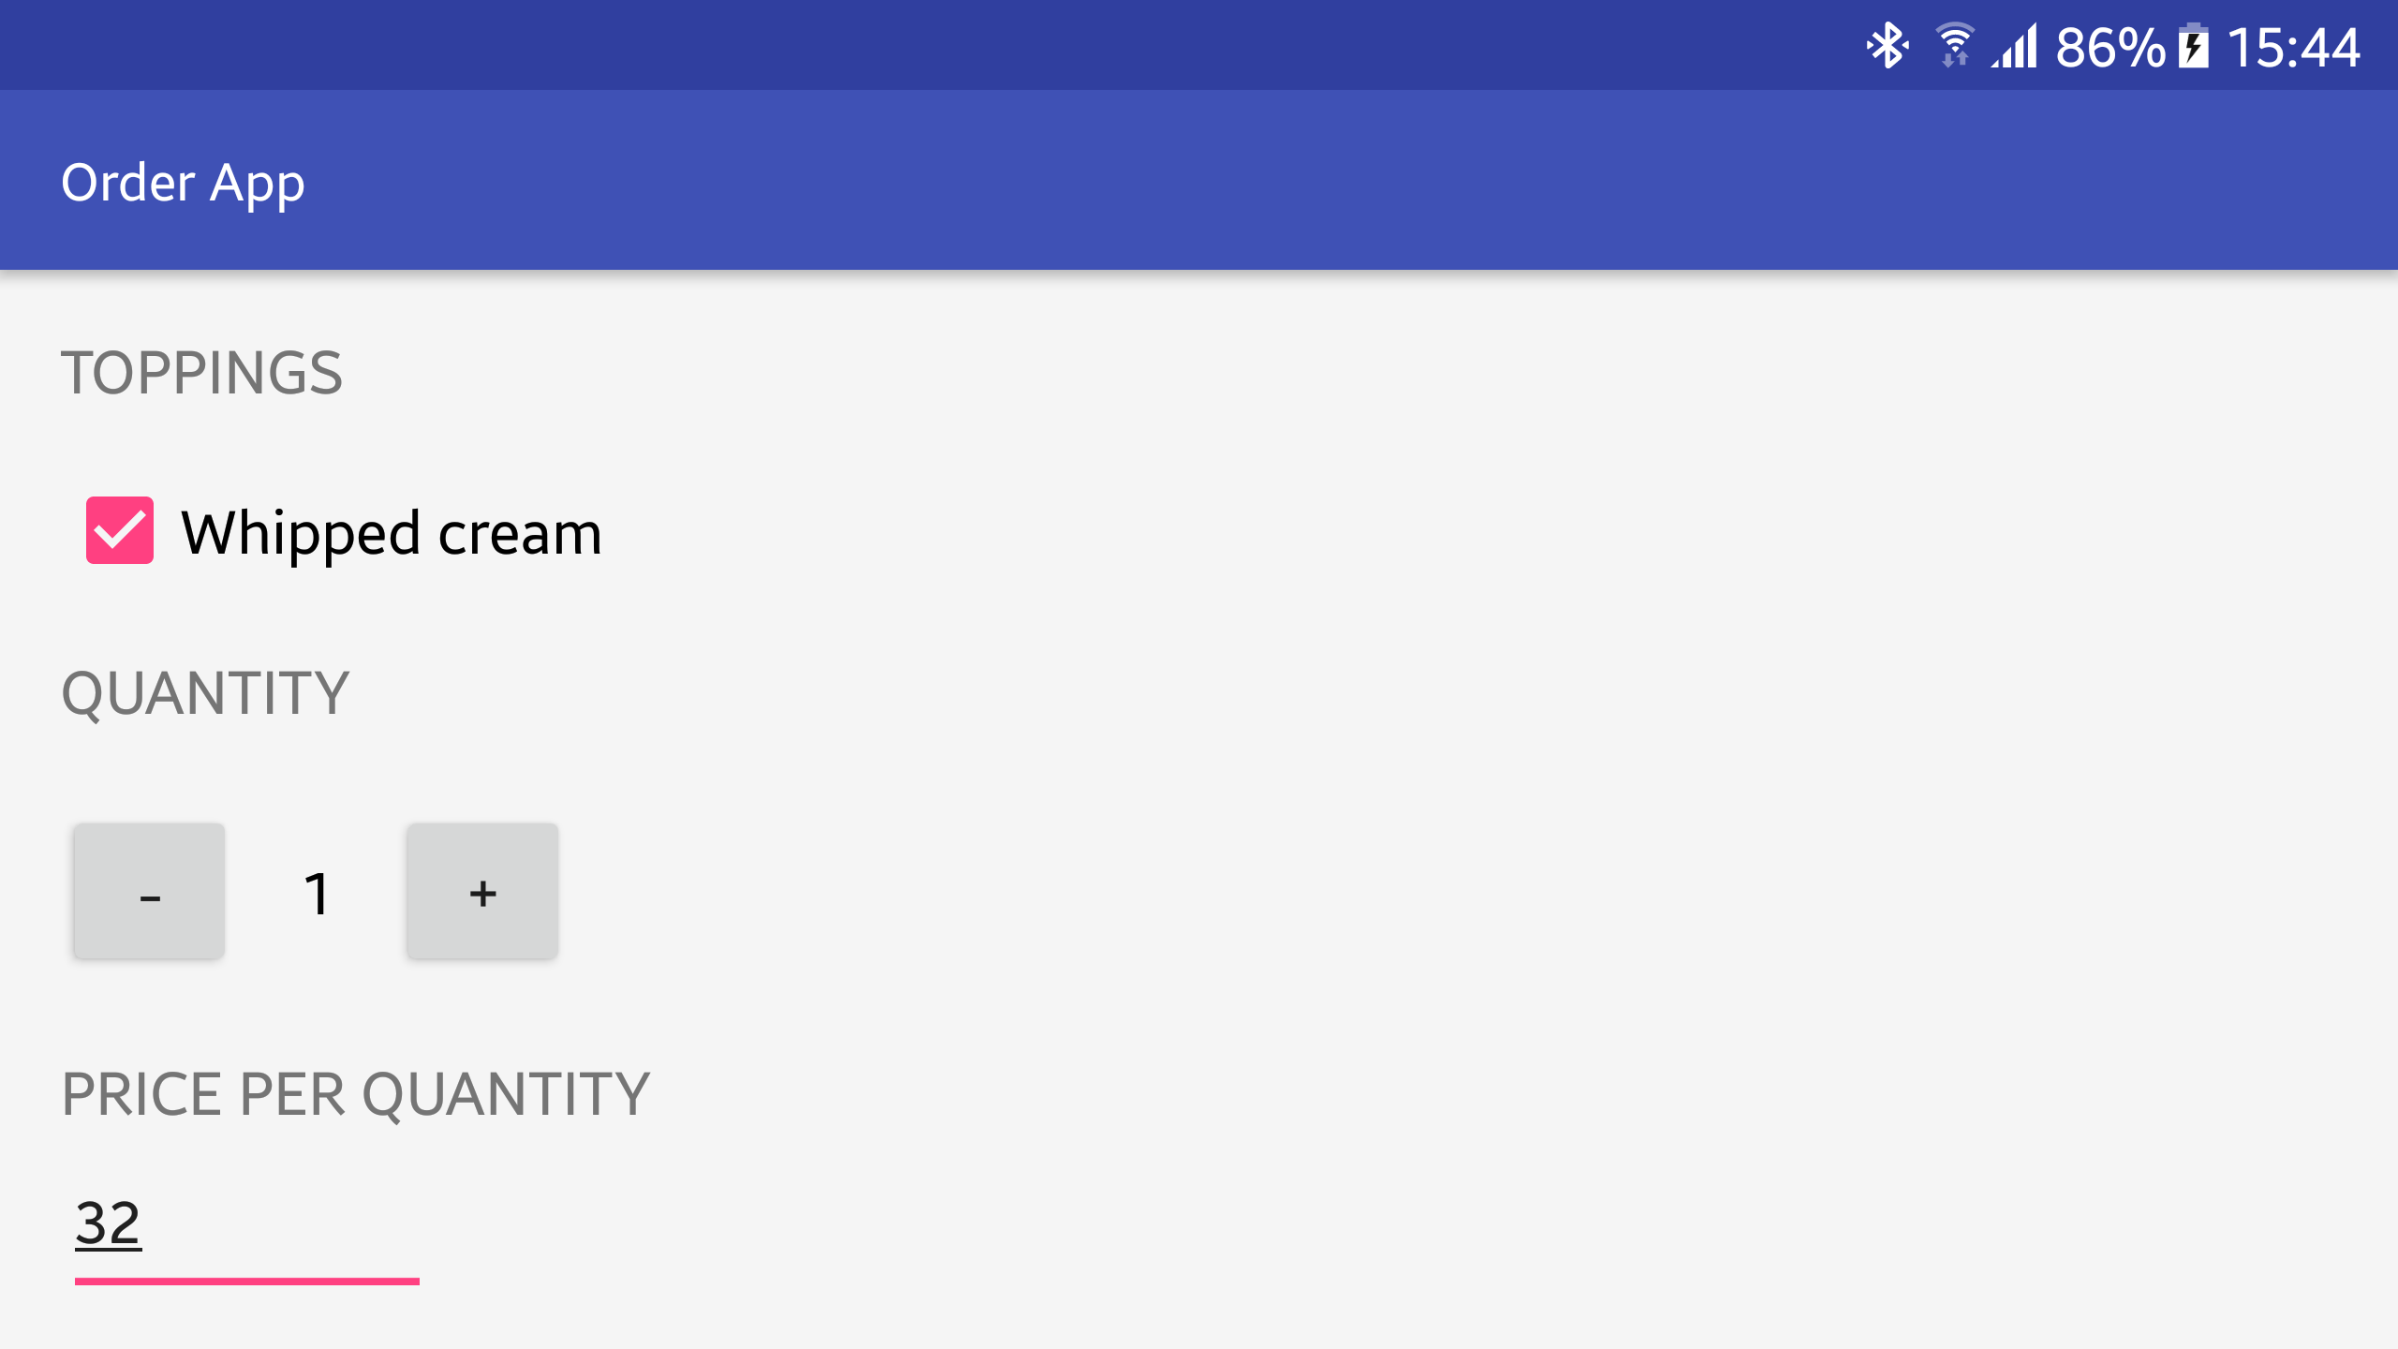
ScrollView
27
If you turn your device to Landscape, you can see that some of the views are disappeared and cannot be used.
In order to fix this issue, we need to change the root view to a ScrollView.
ScrollView can contain only one view, usually a LinearLayout.
ScrollView only supports vertical scrolling. For horizontal scrolling, use HorizontalScrollView.
<ScrollView xmlns:android="http://schemas.android.com/apk/res/android" android:layout_width="fill_parent" android:layout_height="fill_parent"> <LinearLayout ….
</LinearLayout>
</ScrollView>

Slide 28
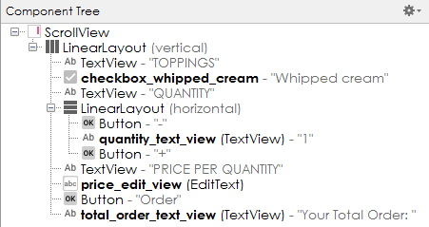
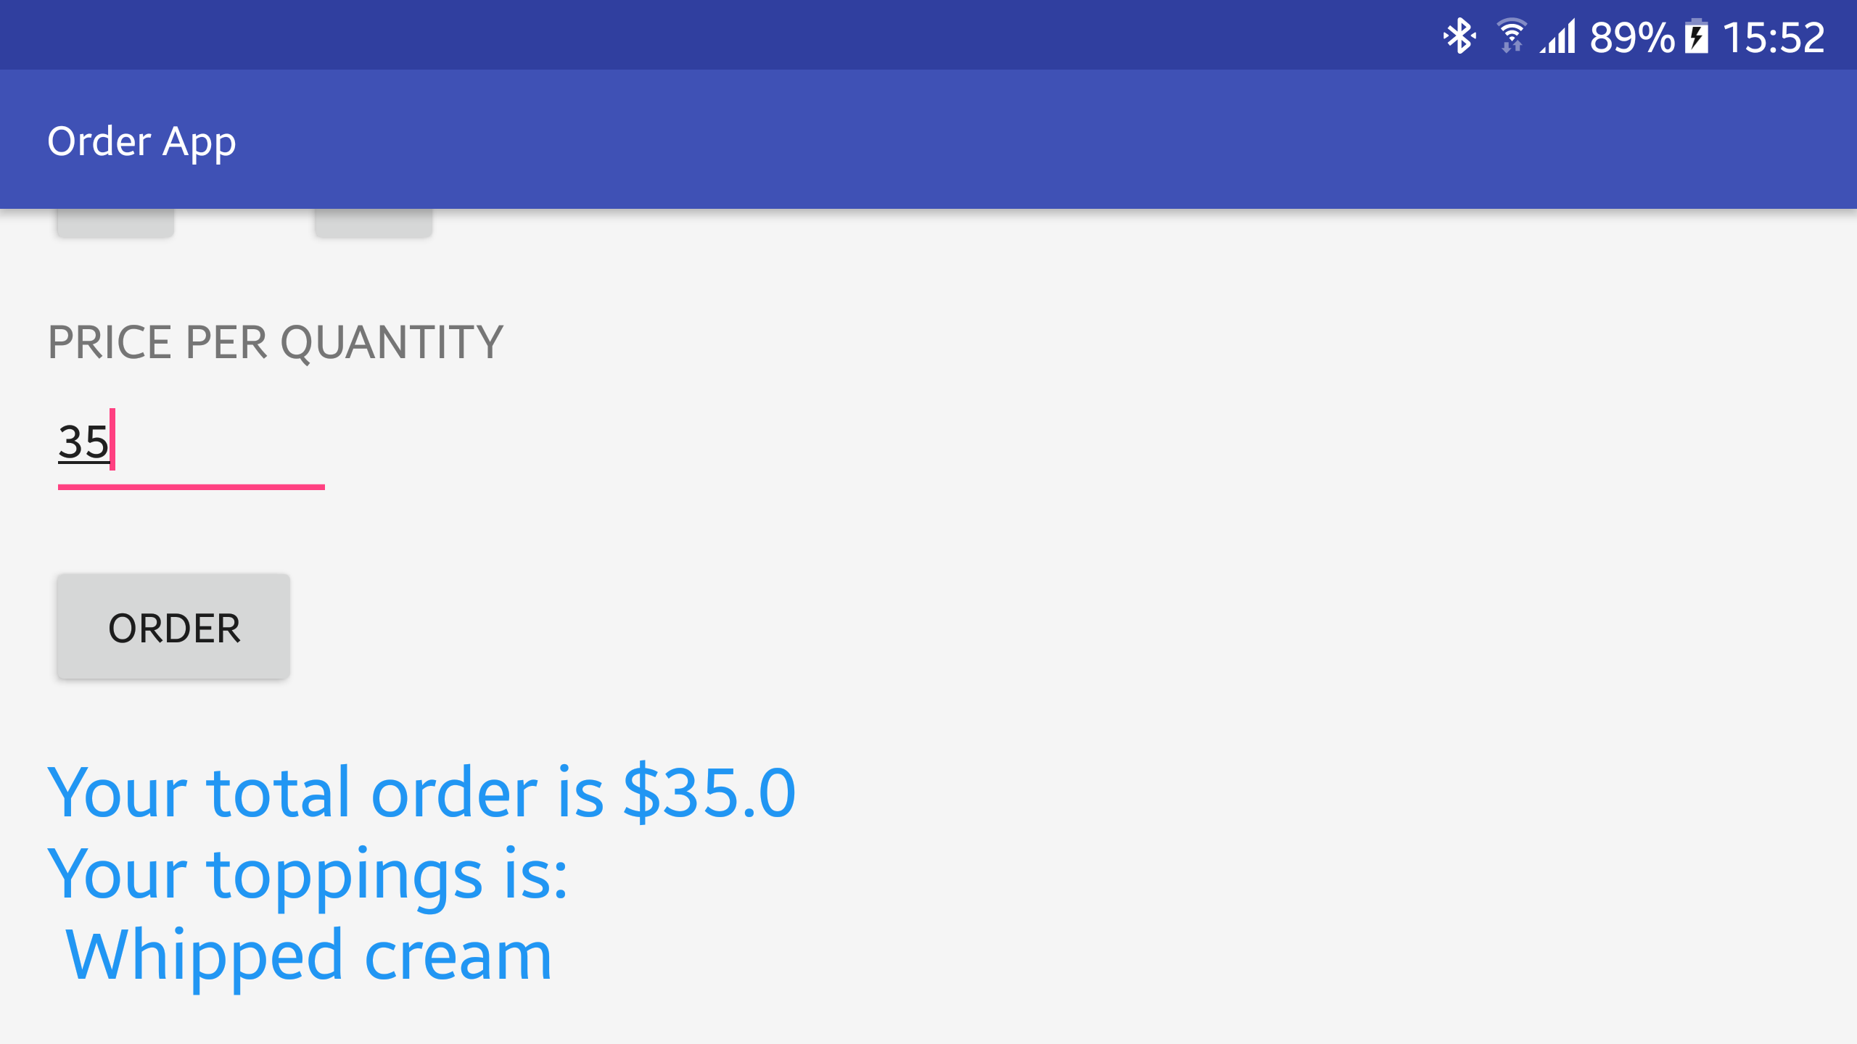
ScrollView Order App
28
In order to solve the problem in the order app, add a ScrollView as the root view:

Slide 29

Elevation
29
Elevation is a view attribute that helps users understand the relative importance of each element and focus their attention to the task at hand.
It drops a shadow under the view giving filling that the view stands higher than other views:
Note that elevation requires the view to have a different background color than other views.
android:elevation="8dp"

Slide 30
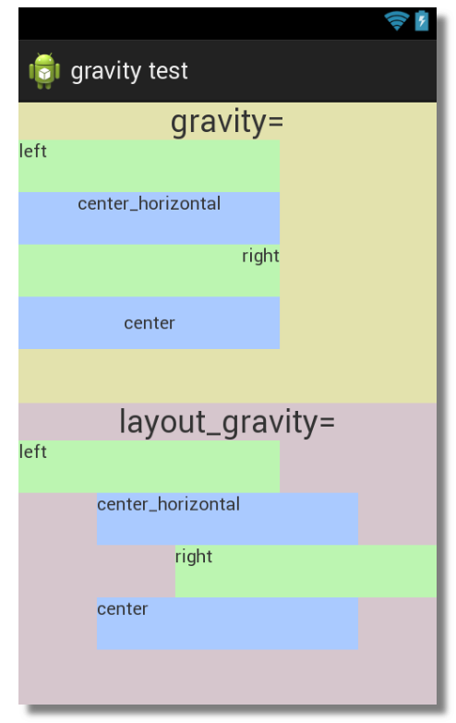
gravity vs layout_gravity
30
gravity arranges the content inside the view.
layout_gravity arranges the view's position outside of itself (inside it’s parent).

Slide 31
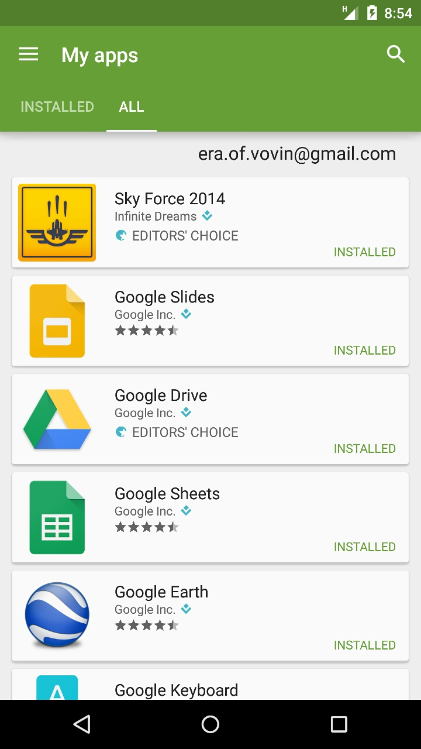
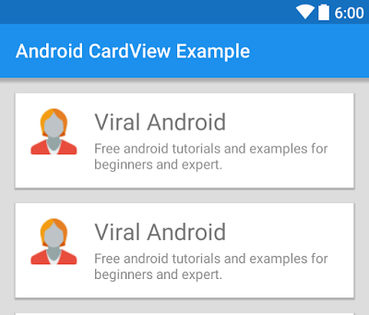
ScrollView CardView
31
CardView is a container that shows information inside cards with customizable corners and elevation, etc.

Slide 32
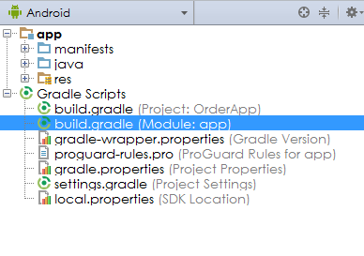
ScrollView CardView Order App
32
In order to use CardView, we need to modify the app dependency:
Open build.gradle of the app:
In dependencies add and rebuild the app:
compile 'com.android.support:cardview-v7:26+'

Slide 33
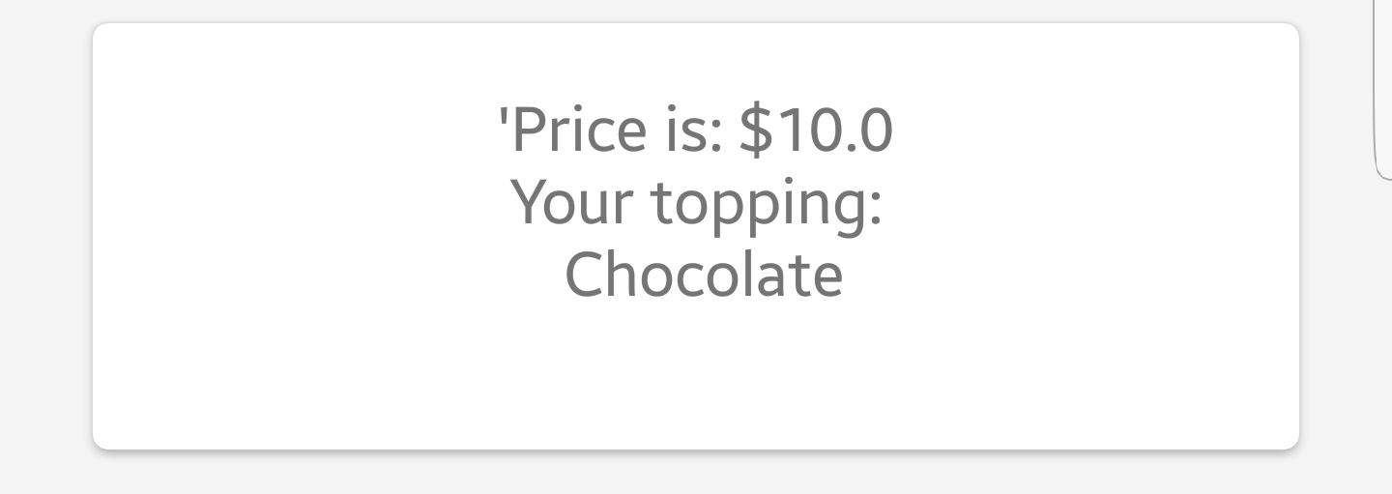
ScrollView CardView Order App
33
Replace the total_order_text_view with:
<android.support.v7.widget.CardView android:id="@+id/card_view_report" android:layout_width="match_parent" android:layout_height="wrap_content" android:layout_gravity="center" android:layout_margin="8dp" android:elevation="4dp" android:visibility="gone" app::cardCornerRadius="4dp" > <TextView android:id="@+id/total_order_text_view" android:layout_width="match_parent" android:layout_height="match_parent" android:gravity="center_horizontal|center_vertical" android:padding="16dp" android:textSize="16sp"/> </android.support.v7.widget.CardView>

Slide 34
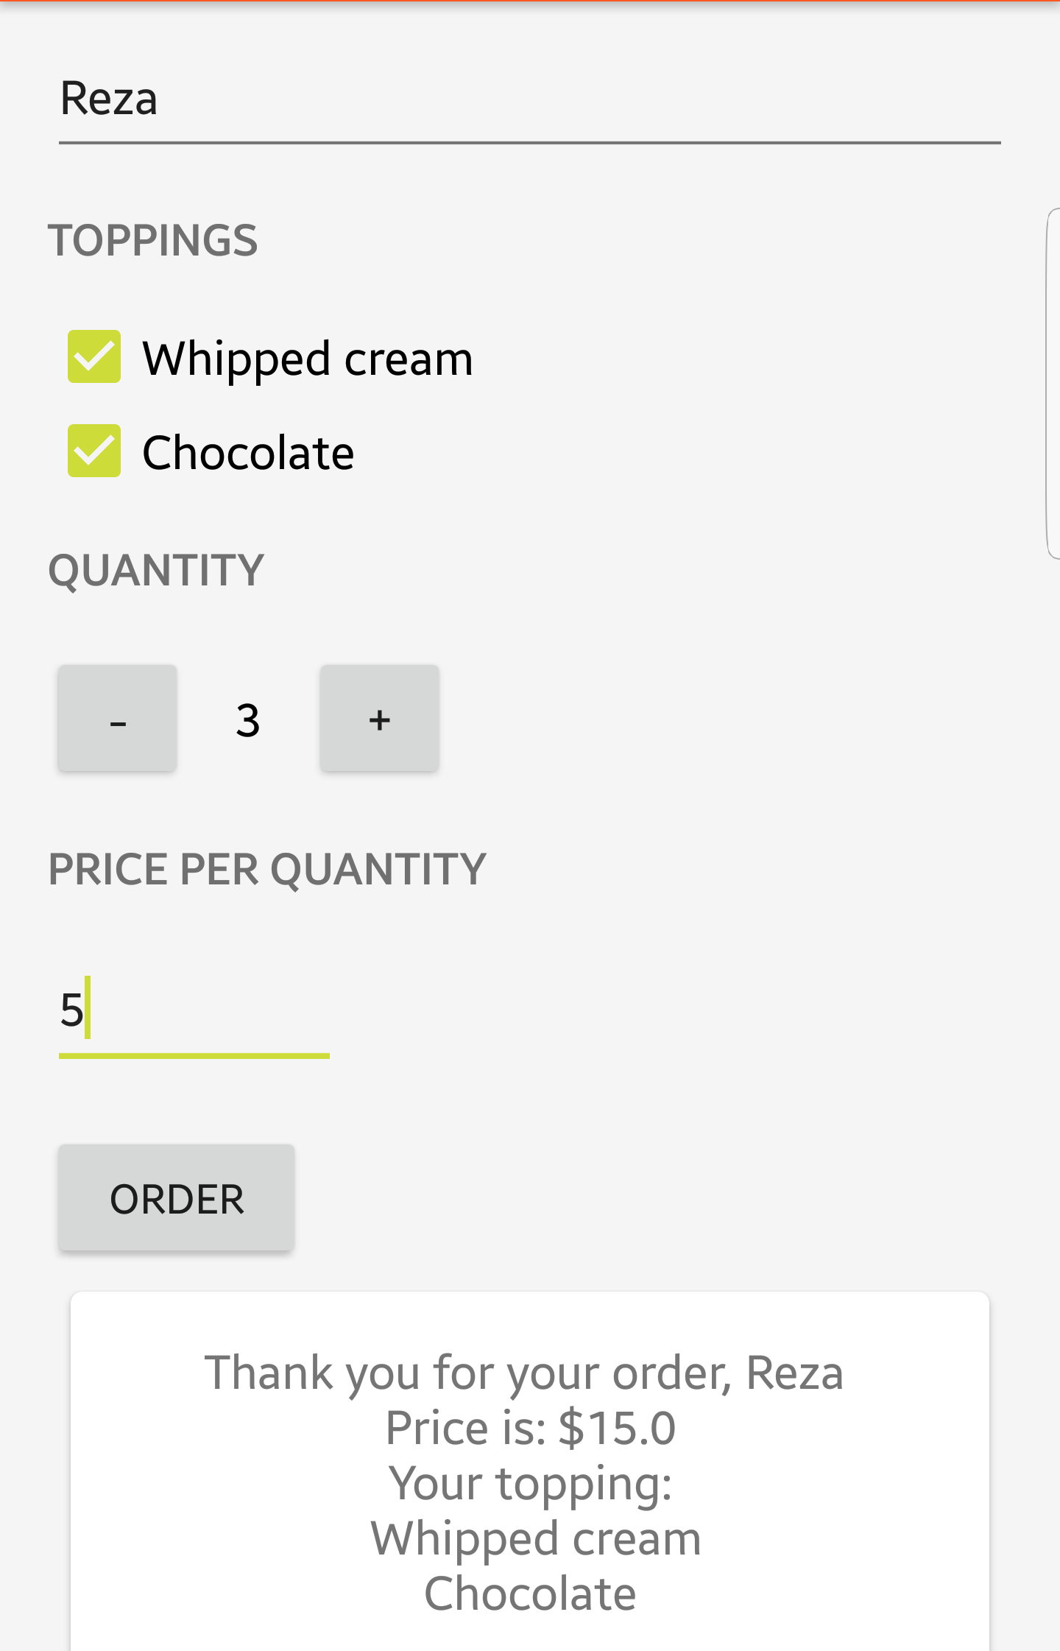
ScrollView Order App
34
Add a new EditText and checkbox, and modify your code to provide the following report:
The Java code needs to query the UI to identify which of the toppings are selected.
Hint: you can use Java Lists to create a list of the selected toppings.

Slide 35

Intents
35

Slide 36
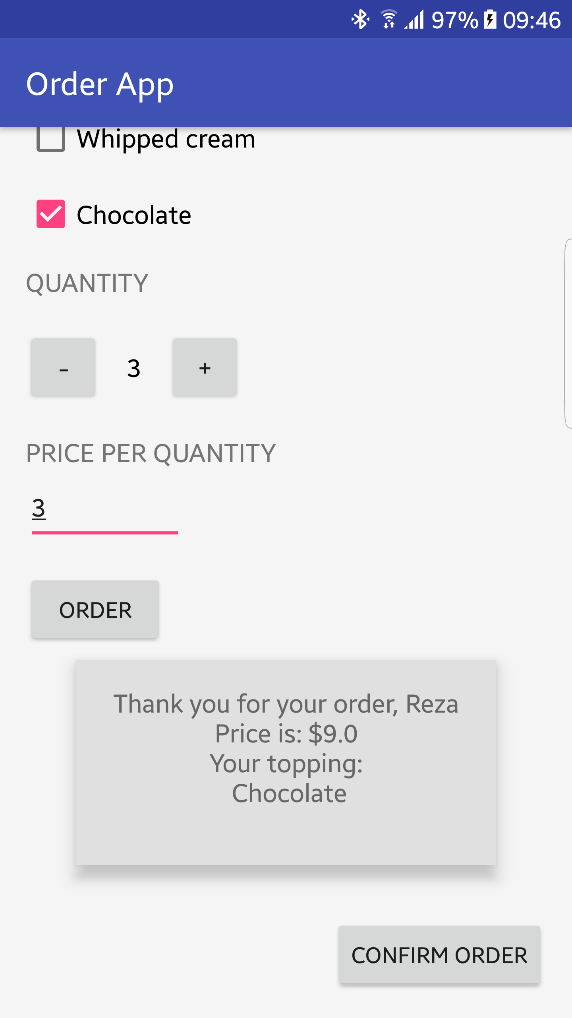
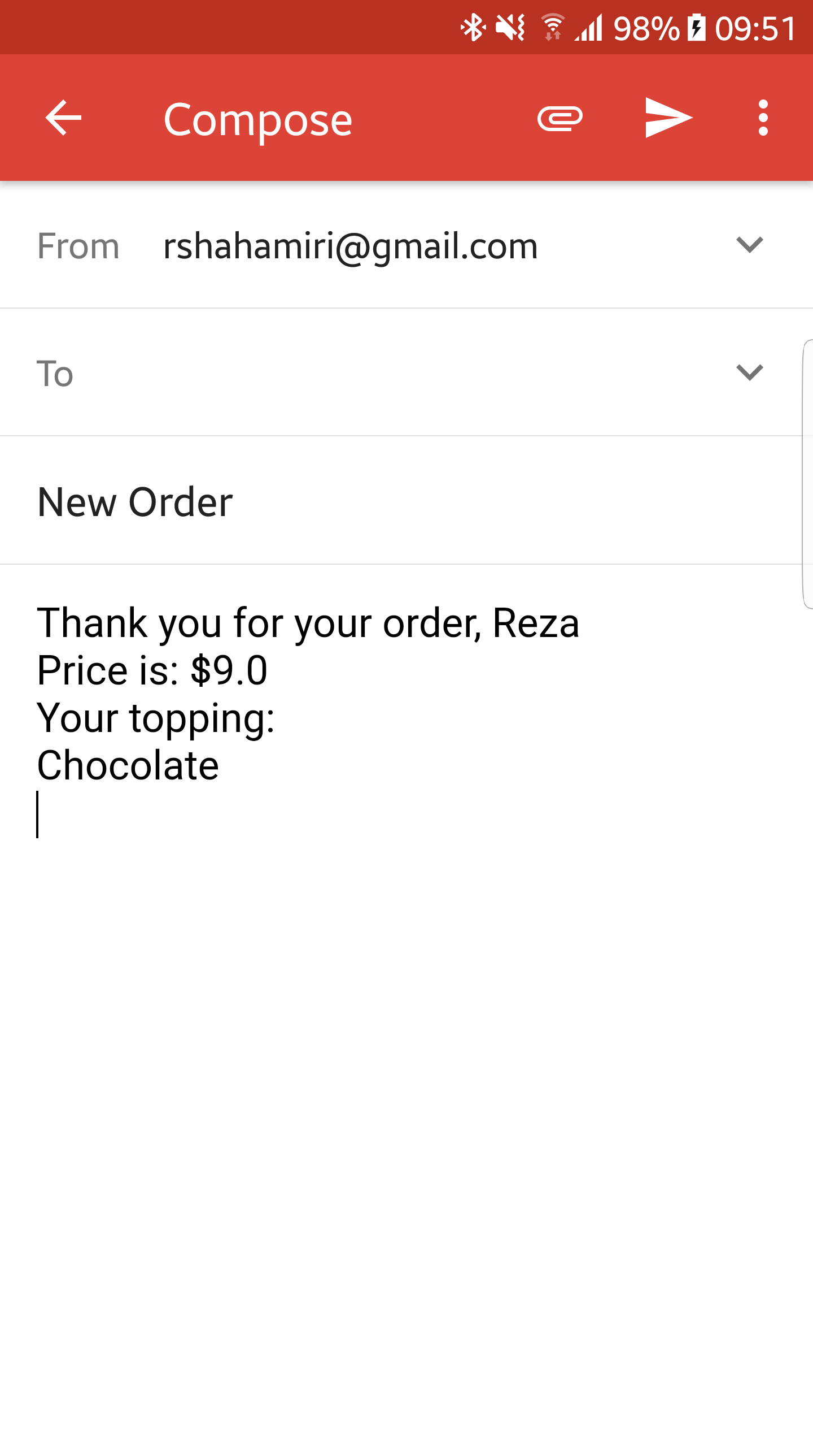
Intent Order App
36
Add a “Confirm Order” button to the app that sends the order email.
Use this link to understand how to use Email intent.

Slide 37
Imposter Syndrome
37

